Slide 1

Exploratory Data Analysis on AMEO Dataset
VANITA DESHMUKH

Slide 2
About me
Civil Engineering (BE )
I want to learn Data Science because I'm interested in using information to solve problems and make things better.
Any work experience (Yes, I have four years of experience in the construction industry.
Share your linkedin and github profile urls
linkedin
https://www.linkedin.com/in/vanitadeshmukh121/
github
https://github.com/VanitaDeshmukh

Slide 3
Agenda (This should be the PPT flow)
Business Problem and Use case domain understanding(If Required)
Objective of the Project
Web Scraping – Details (Websites, Processor you followed)
Summary of the Data
Exploratory Data Analysis:
Data Cleaning Steps
Data Manipulation Steps
Univariate Analysis Steps
Bivariate Analysis Steps
Key Business Question
Conclusion (Key finding overall)
Q&A Slide
Your Experience/Challenges working on Web Scraping – Data Analysis Project.

Slide 4
Business Problem Statement
Objective of the Project:
Exploratory Data Analysis (EDA):
Analyzing distributions of variables.
Investigating relationships between variables.
Research Questions:
Testing salary claim.
Exploring gender-specialization relationship.
Conclusion:
Summarizing key findings.
Providing recommendations.
The objective of the project is to conduct exploratory data analysis (EDA) on the Aspiring Minds Employment Outcome 2015 (AMEO) dataset to:
Gain insights into the employment outcomes of engineering graduates.
Understand the factors influencing salary expectations and specialization preferences among graduates.
Provide recommendations for optimizing recruitment strategies and improving graduate outcomes based on data-driven insights.

Slide 5
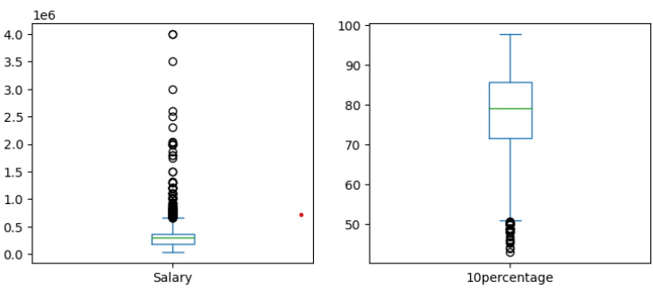
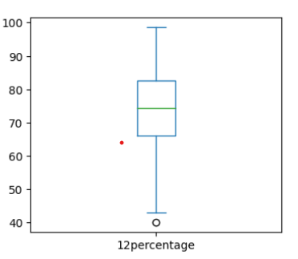
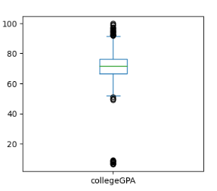
Univariate Numerical Analysis
Salary:
Salary has a wide range of values, with the minimum salary being $35,000 and the maximum being $4,000,000.
The mean salary is approximately $307,700, with a median of $300,000, indicating a positively skewed distribution.
10th Percentage:
10th percentage ranges from 43% to 97.76%, with a mean of approximately 77.93% and a median of 79.15%.
Overall, the distribution seems relatively symmetric and centered around the mean.
12th Percentage:
12th percentage varies from 40% to 98.7%, with a mean of approximately 74.47% and a median of 74.4%.
The distribution appears to be approximately symmetric (skew = -0.03) with minimal kurtosis (kurt = -0.63).
College GPA:
College GPA ranges from 6.45 to 99.93, with a mean GPA of approximately 71.49 and a median of 71.72.
The distribution is negatively skewed (skew = -1.25) and exhibits high positive kurtosis (kurt = 10.23), indicating a significant departure from normality.

Slide 6
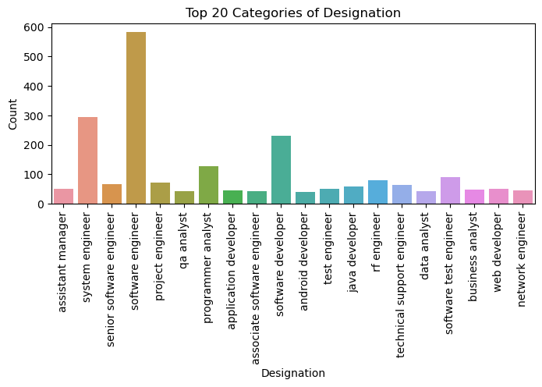
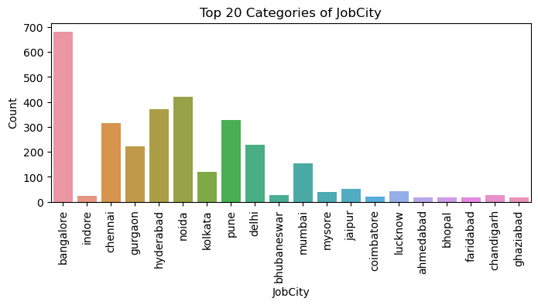
Univariate Categorical Analysis
Among the dataset's job titles or roles, the most frequent designation is 'Software Engineer', with a count ranging from 500 to 600. Conversely, ‘android developer' and ‘data analyst have the lowest counts compared to other designations.
Regarding job locations, the highest count of jobs is observed in Bangalore, ranging from approximately 600 to 700. Conversely, Bhopal, gaziabad, farindabad, Ahmedabad & coimbatore has the lowest count of jobs compared to other cities.

Slide 7
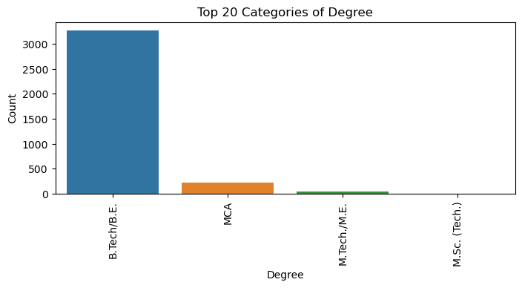
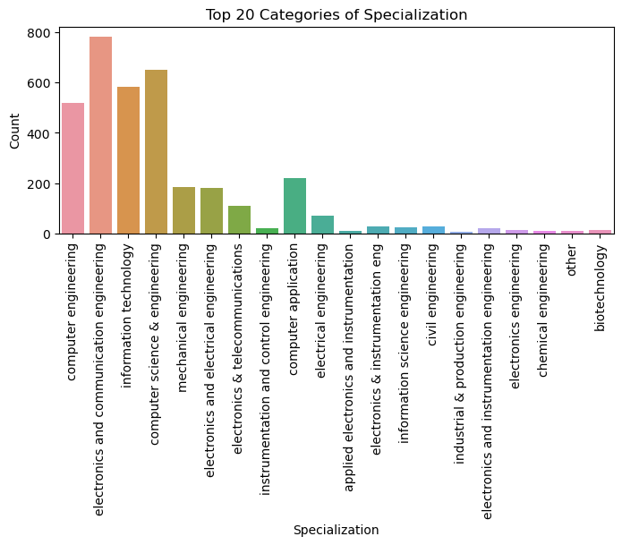
The top 20 degree plot reveals that B.Tech/BE boasts the highest count, while M.Sc. (Tech) exhibits the lowest count.
Among specializations, electronics and communication engineering, along with computer science & engineering, show the highest counts.
Conversely, the specializations with the lowest counts include chemical engineering, industrial & production engineering, and other disciplines.

Slide 8
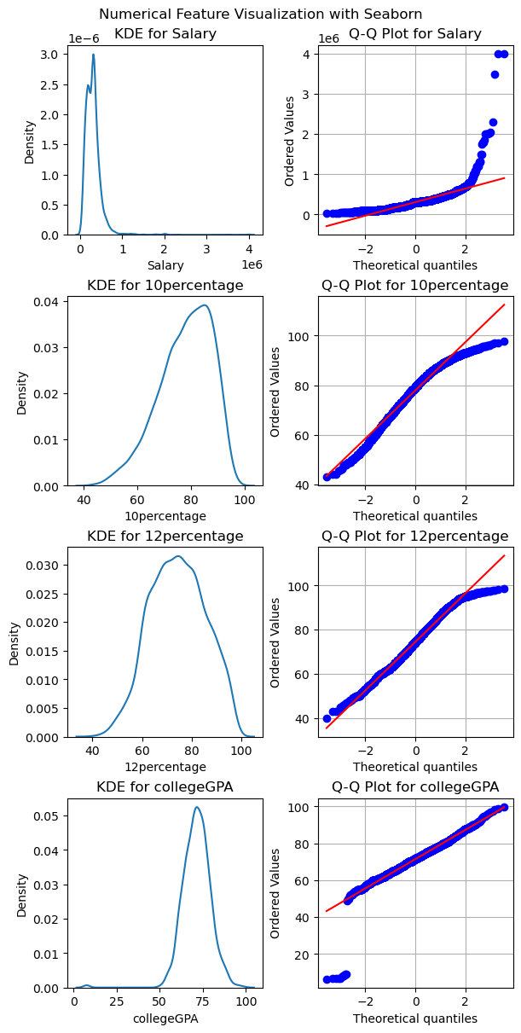
Univariate Numerical Analysis
Salary:
Shapiro-Wilk test indicates a significant departure from normality (p < 0.05), suggesting the distribution is likely not Gaussian.
The visualization reveals potential outliers with salaries significantly higher than the median, indicating possible high-income earners.
10percentage:
Shapiro-Wilk test shows a significant departure from normality (p < 0.05), indicating a non-Gaussian distribution.
Histogram suggests a skewed distribution, potentially indicating variations in academic performance among students.
12percentage:
Shapiro-Wilk test demonstrates a significant deviation from normality (p < 0.05), implying a non-Gaussian distribution.
Bimodal distribution observed in the histogram indicates the presence of two distinct peaks, suggesting differences in academic performance among students.
collegeGPA:
Shapiro-Wilk test reveals a significant departure from normality (p < 0.05), indicating a non-Gaussian distribution.
Probability plot deviations from the diagonal line suggest departures from normality, implying the distribution may not follow a perfect normal distribution.

Slide 9
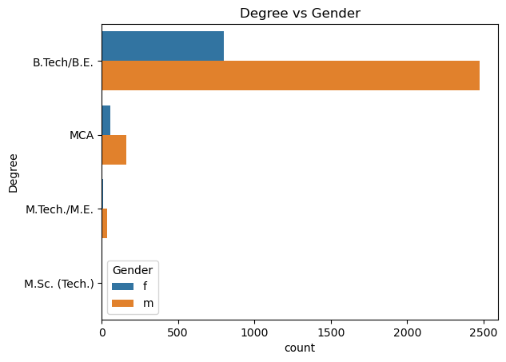
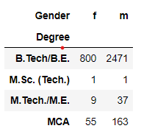
Bivariate Analysis - Categorical vs Categorical
The highest number of males and females hold a degree in B.Tech/BE compared to other degrees.
The chi-square statistic is 2.172 with a p-value of 0.538. At the 0.05 significance level, the null hypothesis (H0) is not rejected.
Thus, there is insufficient evidence to suggest a relationship between individuals' degree and gender.

Slide 10
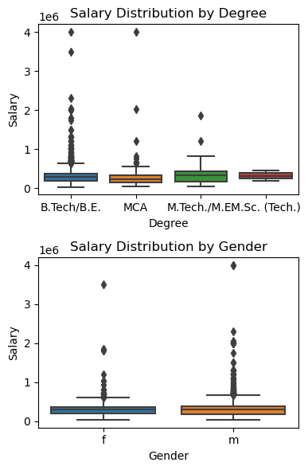
Bivariate Analysis - Categorical vs Categorical
The salary distribution by degree plot indicates that the highest amount of salary is observed for individuals with B.Tech/BE and MCA degrees, with a predominant range of 400,000/Annum, compared to other degrees.
The 25th, 50th (median), and 75th percentiles of the salary distribution across all degrees show approximately equal values, ranging from 0.3 to 0.5.
The salary distribution by gender reveals that the highest salaries are found among males, with a peak in the 400,000 range, compared to females.
The mean salary is approximately equal for both males and females.

Slide 11
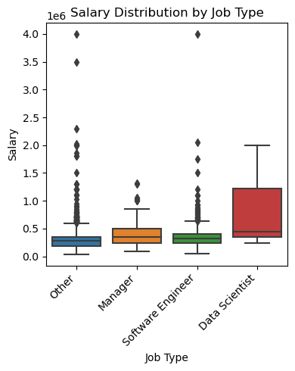
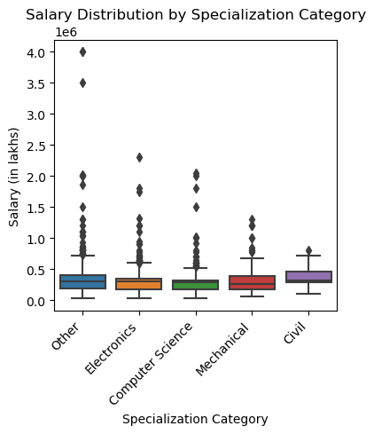
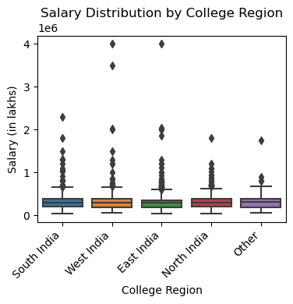
Salary Distribution by Job Type:Data Scientists:
Highest Salary Range: 2.0
Mean Salary: 0.5
75th Percentile: 1.0
No outliers observed
Other Job Types & Software Engineers:
Highest Salary Range: Up to 4.0 (with outliers)
Mean Salary: Typically in the range of 0 to 0.5
75th Percentile: Around 0.4
Salary Distribution by Specialization:
Mean salaries across specializations are approximately equal.
The maximum salary is observed in the "Other" specialization, surpassing those in Electronics, Computer Science, Mechanical, and Civil.
Salary Distribution by College Region:
West India and East India exhibit the highest salaries compared to other regions.
Mean salaries remain consistent across all regions.

Slide 12
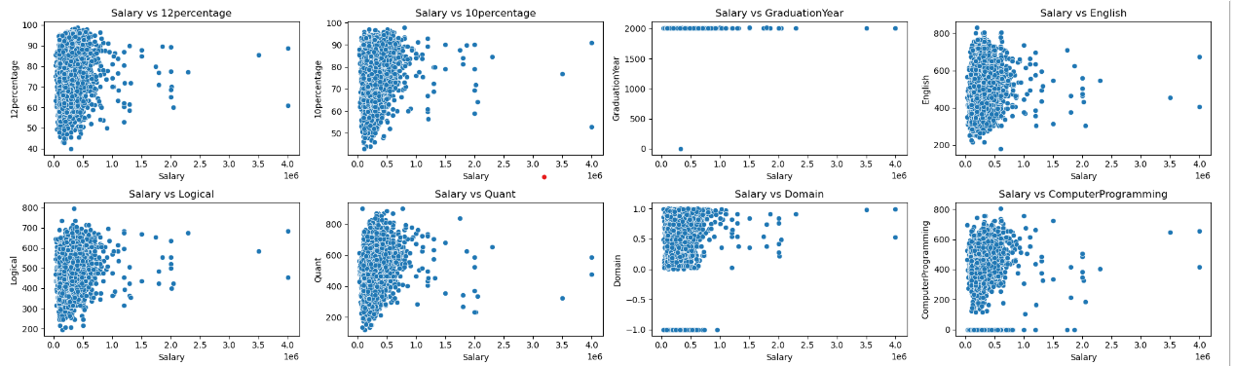
Bivariate Analysis - Numerical vs Numerical
Positive Linear Relationships:
'Salary' exhibits statistically significant positive linear relationships with:
'college GPA', '12percentage', '10percentage', 'English', 'Logical', 'Quant', 'Domain', 'Computer Programming', 'Civil Engg', 'conscientiousness', 'agreeableness', and 'nueroticism'.
Higher values in these columns tend to correspond to higher salaries.
No Significant Linear Relationships:
'Salary' does not show statistically significant linear relationships with:
'Graduation Year’, 'Electronics And Semicon', 'Mechanical Engg', 'Telecom Engg', 'extraversion', and 'openness to experience'.
Salary does not notably vary based on these factors.
Negative Linear Relationships:
'Salary' exhibits statistically significant negative linear relationships with:
'Electrical Engg'.
Higher values in this column tend to correspond to lower salaries.

Slide 13
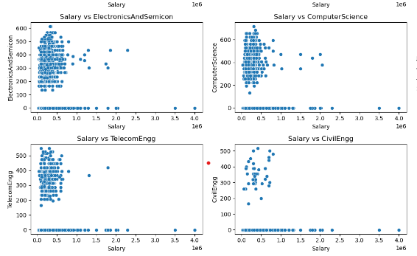
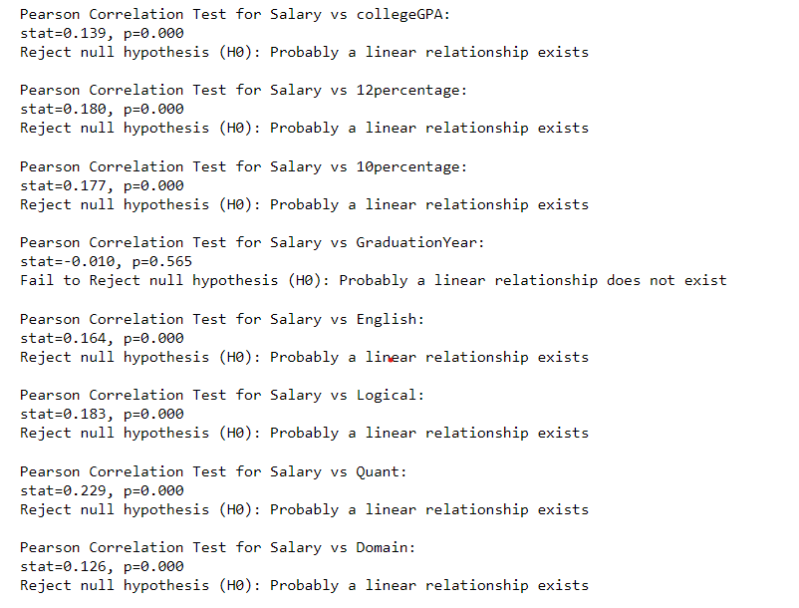

Slide 14
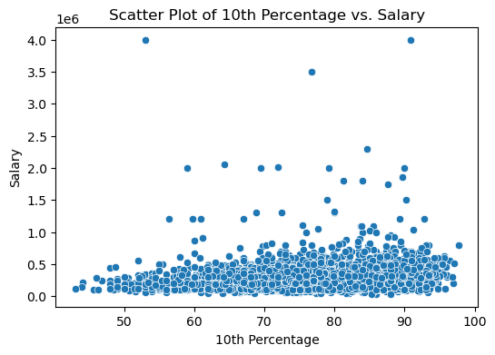
Research Question
Research Question 1: Correlation between academic performance and salary
Correlation between academic performance and salary:
The scatter plot of 10th percentage versus salary indicates a potential positive correlation between academic performance in the 10th grade and salary levels.
As the 10th percentage increases, there seems to be a trend of higher salaries, suggesting that individuals with better performance in their 10th grade examinations may earn higher salaries.

Slide 15
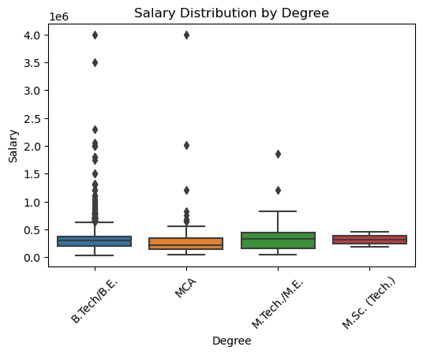
Research Question 2: Salary distributions across different educational degrees
OBSERVATION OF Salary Distribution by Degree:
The plot shows that individuals with degrees in B.Tech/BE and MCA tend to have higher salaries compared to other degrees.
It indicates a potential correlation between educational qualification and salary level, with B.Tech/BE and MCA leading in terms of salary distribution.

Slide 16
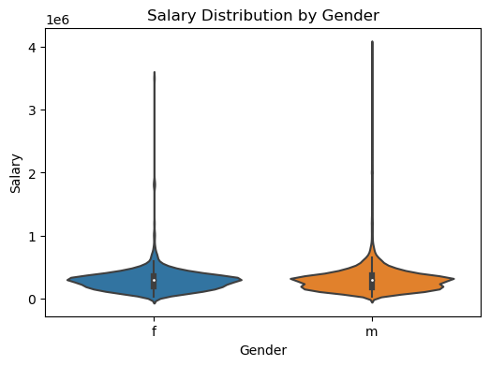
Research Question 3: Impact of gender on salary levels
OBSERVATION OF Salary Distribution by Gender:
The plot suggests that males generally have higher salaries compared to females, as the highest salary range is more prominent for males.
This highlights potential gender disparities in salary levels, warranting further investigation into factors contributing to this gap.

Slide 17
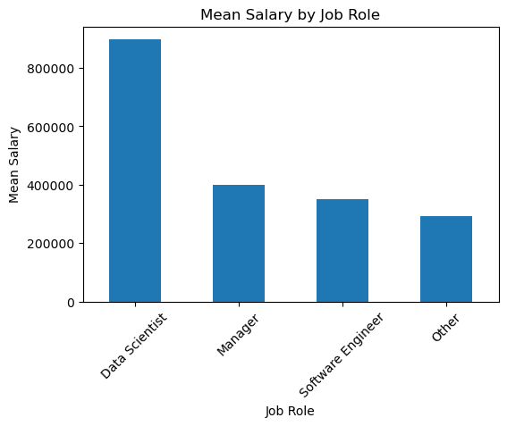
Research Question 4: Salary distributions across different job roles
OBSERVATION OF Salary Distribution by Job Type:
Data Scientists appear to have the highest salary range, indicating the demand and premium associated with this role.
The presence of outliers in other job types suggests variability in salary levels within those roles, possibly due to factors like experience, skills, or industry.

Slide 18
Conclusion
Degree and Gender Distribution:
B.Tech/BE is the most common degree for both males and females.
The chi-square test suggests no significant relationship between degree and gender.
Salary Distribution:
The highest salaries are typically observed for B.Tech/BE and MCA graduates, with outliers indicating exceptionally high earners.
Salary distributions by gender show comparable median salaries, but males tend to have higher maximum salaries.
Data scientists command the highest salaries, with other job types also exhibiting high maximum salaries but with outliers.
Academic Performance:
Academic performance metrics such as 10th, 12th percentages, and college GPA demonstrate non-Gaussian distributions, with significant departures from normality.
Variations in academic performance are evident, indicated by skewed distributions and bimodal patterns.
Specialization and College Region Impact:
While mean salaries are consistent across different specializations and regions, outliers contribute to variations in maximum salaries.
West India and East India regions exhibit higher salaries compared to others, suggesting regional impacts on salary trends.
Overall Implications:
The analysis provides insights into the distribution of salaries, academic performance, and their relationships with degrees, gender, specializations, and regions.
These findings can inform strategic decisions for individuals, educational institutions, and employers in understanding and navigating the job market landscape.

Slide 19

THANK YOU

